Slide 1

Université de Mostaganem — Dr. Madani BELACEL
TIC COURSE 10
Internet Services
Dr. BELACEL Madani
Année universitaire 2026-2027 / Academic Year 2026-2027
Université de Mostaganem - Département Mathématiques et Informatique

Slide 2
Université de Mostaganem — Dr. Madani BELACEL
Course Outline
▪ 1. Service Overview
▪ 2. Cloud Computing
▪ 3. Collaborative Work
▪ 4. E-commerce and Online Services
▪ 5. Social Media
▪ 6. Security of Online Services
▪ 7. Toward Responsible Use

Slide 3
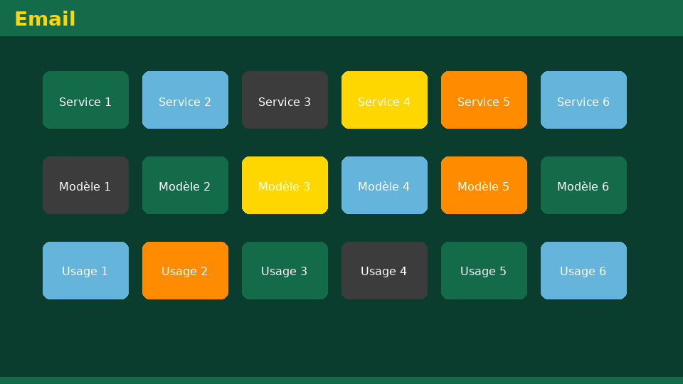
Université de Mostaganem — Dr. Madani BELACEL
Section 1
Service Overview

Slide 4

Université de Mostaganem — Dr. Madani BELACEL
1 - Service Overview
▪ The Web: browsing pages and websites.
▪ Email: asynchronous communication.
▪ File transfer: FTP, cloud storage.
▪ Instant messaging and video conferencing.
▪ Streaming, e-commerce, e-government, e-learning.

Slide 5
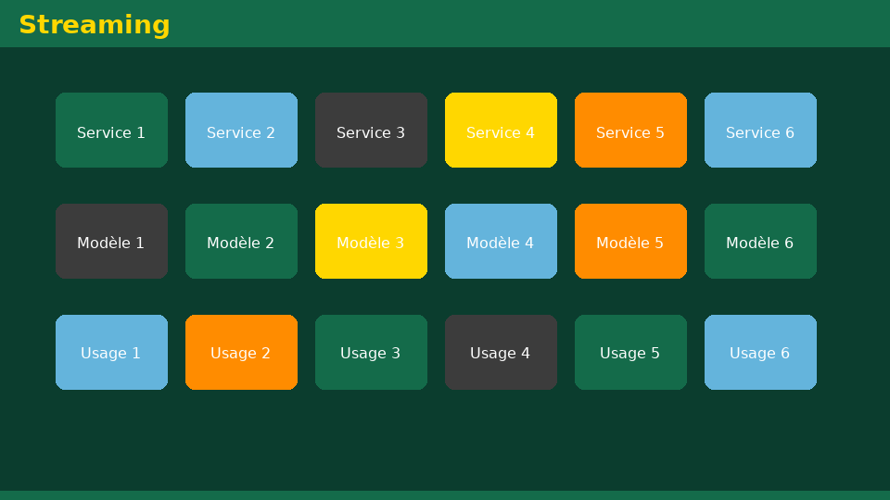
Université de Mostaganem — Dr. Madani BELACEL
Section 2
Cloud Computing

Slide 6

Université de Mostaganem — Dr. Madani BELACEL
2 - Cloud Computing
▪ Storage and computing on remote servers.
▪ Access from any connected device.
▪ Examples: Google Drive, OneDrive, Dropbox, iCloud.
▪ Models: SaaS, PaaS, IaaS.
▪ Benefits: backup, collaboration; limit: requires connectivity.

Slide 7

Université de Mostaganem — Dr. Madani BELACEL
Section 3
Collaborative Work

Slide 8

Université de Mostaganem — Dr. Madani BELACEL
3 - Collaborative Work
▪ Shared documents edited simultaneously (Google Docs, Office 365).
▪ Project platforms: Trello, Teams, Slack.
▪ Video conferencing: Meet, Zoom, Teams.
▪ Wikis and co-writing spaces.

Slide 9

Université de Mostaganem — Dr. Madani BELACEL
Section 4
E-commerce and Online Services

Slide 10

Université de Mostaganem — Dr. Madani BELACEL
4 - E-commerce and Online Services
▪ Online shopping: Amazon, Jumia, local stores.
▪ Electronic payment: CIB, EDAHABIA, bank cards.
▪ Online banking and digital wallets.
▪ Digital government: taxes, university registration.

Slide 11

Université de Mostaganem — Dr. Madani BELACEL
Section 5
Social Media

Slide 12

Université de Mostaganem — Dr. Madani BELACEL
5 - Social Media
▪ Facebook, Instagram, X (Twitter), LinkedIn, TikTok.
▪ Personal and professional uses (LinkedIn = virtual CV).
▪ Recommendation algorithms and filter bubbles.
▪ Risks: disinformation, cyberbullying, privacy invasion.
▪ Good practice: configure privacy settings.

Slide 13

Université de Mostaganem — Dr. Madani BELACEL
Section 6
Security of Online Services

Slide 14

Université de Mostaganem — Dr. Madani BELACEL
6 - Security of Online Services
▪ Two-factor authentication (2FA).
▪ Managing third-party app permissions.
▪ Regular backups of your data.
▪ GDPR / law 18-07: rights over personal data.

Slide 15
Université de Mostaganem — Dr. Madani BELACEL
Section 7
Toward Responsible Use

Slide 16
Université de Mostaganem — Dr. Madani BELACEL
7 - Toward Responsible Use
▪ Controlled screen time and digital hygiene.
▪ Verify sources before sharing.
▪ Respect for others: netiquette and digital citizenship.
▪ Digital carbon footprint: digital sobriety.

Slide 17
Université de Mostaganem — Dr. Madani BELACEL
Practical Interest
▪ Use the cloud so you never lose your documents again.
▪ Collaborate remotely on student projects.
▪ Handle your administrative tasks online.
▪ Build your professional profile on LinkedIn.

Slide 18
Université de Mostaganem — Dr. Madani BELACEL
Self-Assessment (MCQ)
1. What does SaaS stand for?
a) Software as a Service
b) System as an Application
c) Storage and Access Service
2. 2FA is used to:
a) Speed up connection
b) Strengthen authentication
c) Compress files
3. Google Drive is a:
a) Cloud storage service
b) Email-only service
c) Social network

Slide 19
Université de Mostaganem — Dr. Madani BELACEL
Conclusion
▪ Internet services transform work, commerce and government.
▪ Cloud, collaboration and e-services offer huge gains.
▪ Safe and responsible use is what makes these benefits real.
▪ End of the module: put every concept into practice!

Slide 20
Université de Mostaganem — Dr. Madani BELACEL
References
- Microsoft Support - OneDrive and Office 365.
- GDPR - data protection guidelines.
- Algerian Law 18-07 on personal data protection.
- ICT Course materials, University of Mostaganem.

Slide 21
Université de Mostaganem — Dr. Madani BELACEL
Thank you for your attention!
Questions?
Dr. BELACEL Madani

